Slide 1
Predicting anchor links across attributed networks via network embedding
Motivation
Related Work
Our Method
Evaluation

Slide 2
Anchor links prediction
Motivation：
Predicting anchor links across social networks has important implications to an array of applications.
Most existing approaches directly work on structural features of social network, such as, degree, clustering coefficient, the number of involved triangles, common neighbors. Without capturing intrinsic structural regularities of social networks, these approaches are particularly sensitive to network structure, and thus slight changes or noises of network structure may result in remarkably different results.
Network embedding preserves specific structural regularities, leveraging observed anchor links as supervised information. This method is robust to slight changes of network structure.

Slide 3
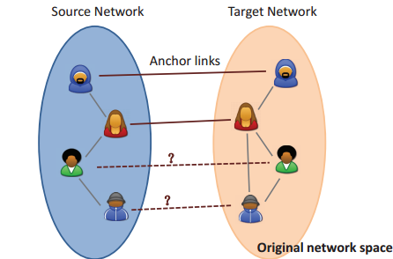
RELATED WORK
Previous works [1, 2] used Network Embedding for anchor links prediction. But they only model the network structure, and does not consider the user profiles.
We propose a novel framework for anchor links prediction. The embedding of an user is jointly trained to predict the anchor links across social networks and the context in the graph.

Slide 4
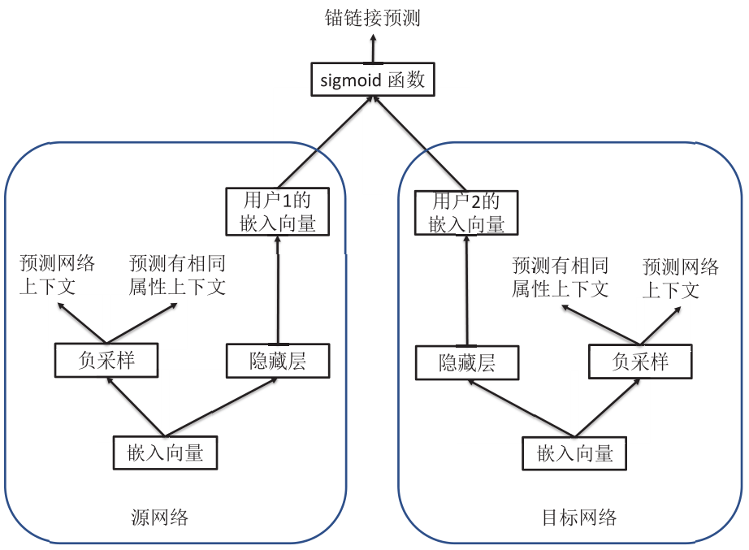
Our method

Slide 5
Learning Embeddings: Examples
Predict nearby words
Predict nearby nodes
Softmax
Softmax
Word embedding
Graph node embedding
Word2vec (Mikolov et al. 2013)
Deepwalk (Perozzi et al. 2014 KDD)

Slide 6
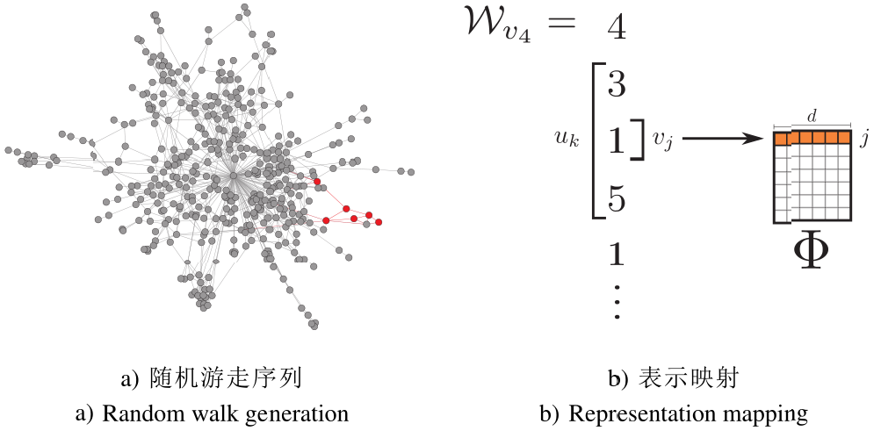
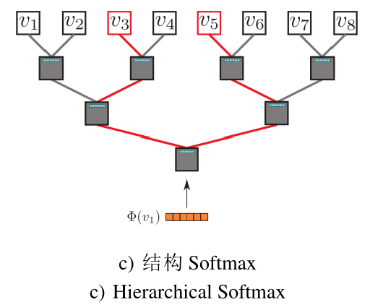
Learning Embeddings: Examples
Deepwalk (Perozzi et al. 2014 KDD)

Slide 7
Context
Predict nearby nodes in
random walk sequences
Predict nodes with the
same class labels
Softmax (approx. by negative sampling)
Graph node embedding
Planetoid (Zhilin Yang et al. 2016 ICML)

Slide 8

Negative Sampling
Context | Positive sample | Negative sample
Graph structure | Nearby nodes in random walk sequences | Random node pairs
Labels | Nodes with the same class labels | Nodes with different class labels
Use a binomial distribution to sample between
graph structure context and label context

Slide 9
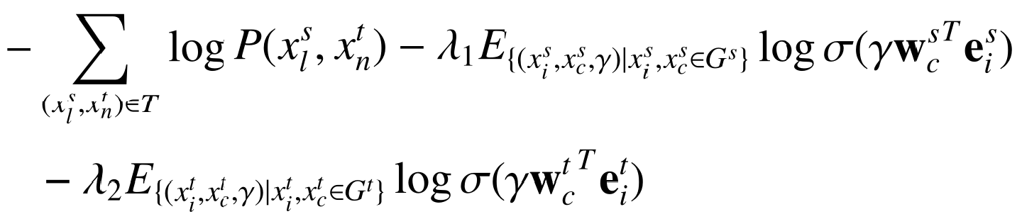
Predicting Anchor Links

Slide 10
Evaluation
Flickr 与 Lastfm 网络：Flickr 与 Lastfm 网络分别有 4935 和 4496 个节点。
Flickr 与 Myspace 网络：Flickr 与 Myspace 网络分别有 6714 和 10733 个节点。
Douban online 与 offline 网络：线下网络包含 1118 个用户，线上（online）网络包含 3906 个节点。
Baseline:
PALE (T. Man et al., 2016 IJCAI),
ULink(X. Mu et al., 2016 KDD),
FINAL(S. Zhang et al., 2016 KDD),
UANE-N（UANE-N 算法只基于网络结构预测上下文，没有利用节点属性信息）。

Slide 11

Evaluation
评价度量：对比一个潜在匹配账号的 top-k 排名列表，正确的对应账号在列表里面的排名越高越好。
对于节点 x，给定了该节点的 top-k 排名列表 {y1,y2,...,yk} 以后，如果 y1是正确的对应账号，则 hit(x) = 1，h(x) = 1。如果 y4是正确的对应账号，则 hit(x) = 4，h(x) =(k−3)/k。

Slide 12
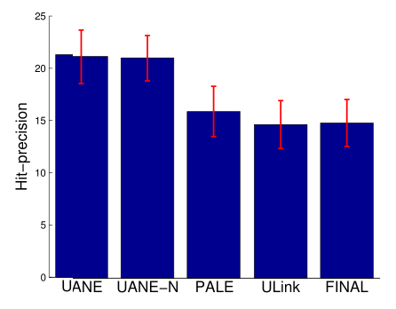
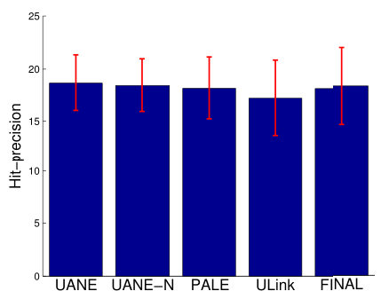
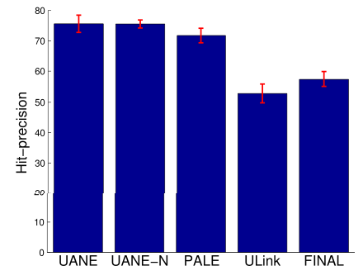
Evaluation
Flickr-Lastfm 网络
Flickr-Myspace 网络
Douban online-offline 网络

Slide 13
Conclusion
我们设计了一个全新的基于网络嵌入的模型 UANE。该模型利用网络结构和节点属性信息预测跨属性网络的节点对应关系。
我们引入了网络嵌入和负采样方法，独立的学习每个属性网络节点的嵌入向量，该低维嵌入向量可以保存网络的二阶邻近，使得有相似的邻域结构和属性信息的节点，其嵌入向量有相似性。
我们利用学习到的嵌入向量作为输入特征，并利用已有的跨属性网络节点对应关系作为监督信息，将它们输入到 sigmoid 层进行跨网络的节点对应关系预测。
实验结果表明 UANE 算法能保存网络的内部结构规则，有效利用网络结构和节点属性信息预测跨属性网络的对应关系，相对于已有的优秀算法表现更好。

Slide 14
References
Li Liu, William K. Cheung, Xin Li*, Lejian Liao, “Aligning Users Across Social Networks Using Network Embedding”, IJCAI 2016.
Tong Man, Huawei Shen, Shenghua Liu, Xiaolong Jin and Xueqi Cheng, Predict Anchor Links across Social Networks via an Embedding Approach IJCAI, 2016.

Slide 15
Thanks

